Slide 1
SUSAN ICE STORE ORDERING AND INVENTORY SYSTEM
Ban Daggao
Rhodney Potoza
Leonard Potian
Nelaine Valdez

Slide 2
Introduction
Susan Ice Store is owned by a single person. The said store only sells its products through a physical store. The proposed system would give the owner of Susan ice store an online ordering system. This is an online system where she would be able to transact with her customers through the orders created.

Slide 3
Proposed System
Ordering system using Website
Inventory system to track orders
Client Server System
User Registration of Account
Auto Compute Orders

Slide 4
Purpose
To gain more customers by deploying the website.
To improve sales by attracting customers to order online.
To make the ordering and inventory transactions faster and convenient.

Slide 5
Scope and Limitation
The system will be PC based only.
The system has a maximum limit of users due to server issues.
The team will be focusing on the function of the proposed system.
The client will be trained on how to use the proposed system.

Slide 6
General Objectives
The goal of this project is to make the transactions easier and help the business of the client increase the customers by using this system.

Slide 7
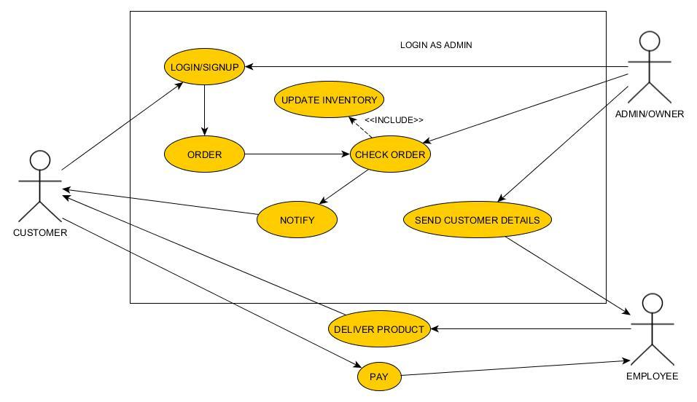
Use case diagram

Slide 8
Figure 1.1.1 Login/Signup
Name | Login
Actor | Customer
Description | Customer need to login to be able to order
Basic Flow | 1.Customer input login information. 2. login successful
Alternative Flow | 2.1 Login unsuccessful 2.1a. Login information is wrong. 2.1b. Connection Problem. 2.1c. Customer not yet registered. 2.2 Customer click register now. 2.3 Customer input name and other required field in order to create account 2.4 Website check registration form 2.5 Account will be added to database 2.6 Customer can now login
Pre-condition | Customer must input correct login information
Post-condition | Customer can order
Assumptions | Customer wants to order product.

Slide 9
Figure 1.1.2 Order
Name | Order
Actor | Customer
Description | Customer place order
Basic Flow | After customer browse the site and found what he/she wants. Click the product. The site will give order form. Customer fill up order form. Send order request. Request sent.
Alternative Flow | Can’t send request 6.1a There is a problem with the connection 6.1b Customer did not fill up all the required field. 6.2 Customer send another request 6.3 Customer will now wait for confirmation
Pre-condition | Customer must click the product he or she wants
Post-condition | Customer will wait for order
Assumptions | There is a problem with the server or connection that’s why the system can’t send request.

Slide 10
Figure 1.1.3 Check Order
Name | Check order
Actor | Owner
Description | Owner will check the order
Basic Flow | Owner will check the order Owner will check the inventory if there are stocks Owner will validate the order Owner will give order to employee Employee will deliver the product
Alternative Flow | 2.1. There is no stock left. 2.2. Owner will contact customer. 2.3 Owner will cancel order.
Pre-condition | Customer must order to the site and complete the requirements
Post-condition | Orders will be delivered
Assumptions | Customer ordered a product

Slide 11
Figure 1.1.4 Login/Signup
Name | Login/Signup
Actor | Owner
Description | This is a login/signup for admin/owner
Basic Flow | 1.Owner input login information 2.Owner access inventory 3.Owner checks stocks 4.Owner checks orders
Alternative Flow | 1.1 Can’t login 1.1a. Login information is wrong 1.2 Owner put login information again. 1.3 Login information correct 1.4 Proceed to basic flow number 2
Pre-condition | Owner must input correct login information
Post-condition | Owner can check stocks and orders
Assumptions | Owner wants to check stocks.

Slide 12
Figure 1.1.5 Notify
Name | Notify
Actor | Owner
Description | Owner verified the order
Basic Flow | 1.Owner check inventory 2.Owner check or verify order 3. Owner send notification to customer 4. Notification sent
Alternative Flow | 4.1 Can’t send notification 2a. There is a problem with connection. 4.2 Owner send another notification 4.3. System proceed to step 4 in basic flow
Pre-condition | Owner must check order details
Post-condition | Owner can send notification properly
Assumptions | Someone ordered

Slide 13
Figure 1.1.6 Update inventory
Name | Update Inventory
Actor | Owner
Description | Owner check stocks.
Basic Flow | 1. Owner log in. 2. Owner check stocks. 3. Owner saw there is only a few stocks left. 4. Owner will order/buy stocks 5. Owner update inventory.
Alternative Flow | 3.1 There is still lot of stocks left. 3.2 Owner will proceed to step 5 in basic flow
Pre-condition | Owner must login.
Post-condition | Owner check and update stocks.
Assumptions | Owner wants to check stocks

Slide 14
Figure 1.1.7 Send Customer Details
Name | Send Customer Details
Actor | Owner
Description | Owner is done checking customer order.
Basic Flow | Owner verified and approved order. Owner send customer details to employee
Alternative Flow | 1.1 Owner Declined order 1.2 Owner will not send anything to employee
Pre-condition | There must be a customer order request
Post-condition | Owner can send details to employee for delivery
Assumptions | Owner wants to check stocks

Slide 15
Figure 1.1.8 Deliver Product
Name | Deliver Product
Actor | Employee
Description | Employee get a customer details from owner
Basic Flow | Employee received customer and order details from owner Employee packed the order Employee Deliver product.
Alternative Flow | 1.1 Employee Did not received any customer details or order details Employee will not deliver anything Employee will continue making different kind of ice.
Pre-condition | There must be an approved order.
Post-condition | Employee will deliver product
Assumptions | There is a customer order need to be delivered

Slide 16
Figure 1.1.9 Pay
Name | Pay
Actor | Customer
Description | Payment process
Basic Flow | Customer received product. Customer pay to the employee Via Cash on delivery
Alternative Flow | 1.1Customer did not received anything 1.1a. Customer did not order anything 1.1b. Order has been declined
Pre-condition | Customer must order something.
Post-condition | Customer order will be delivered.
Assumptions

Slide 17
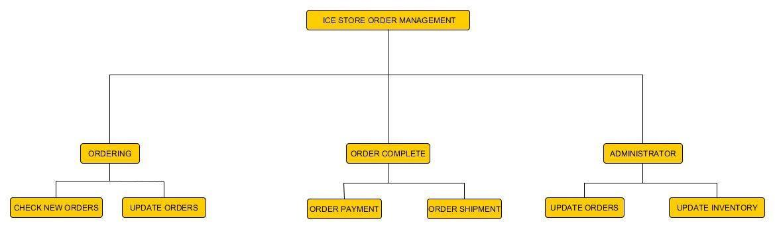
Figure 2.0 Function Decomposition Diagram
This diagram shows the different functions that happened inside the proposed system

Slide 18
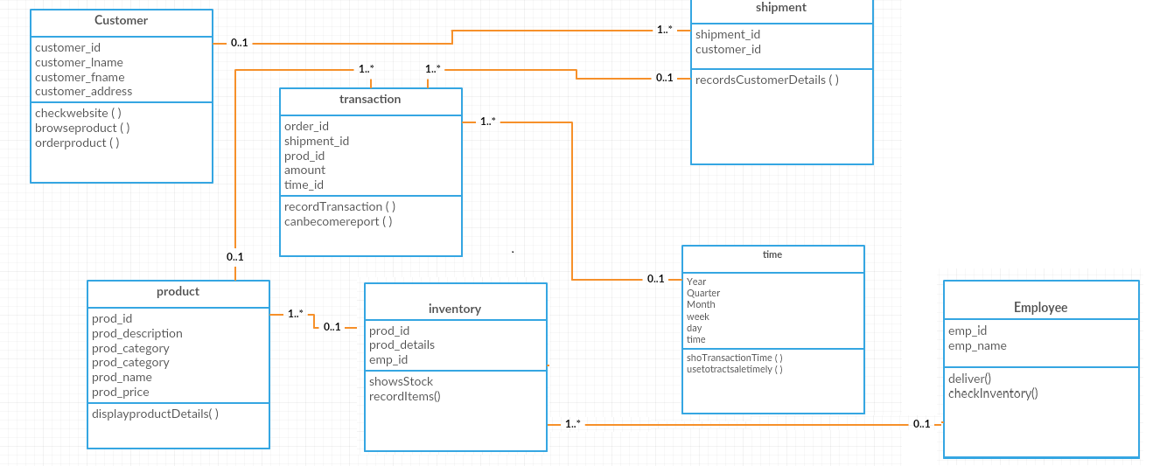
Figure 3.0 Class Diagram
This diagram provides an overview of the target system by describing the objects and classes
inside the system and the relationships between them, in this diagram
it also shows what the class can do.

Slide 19
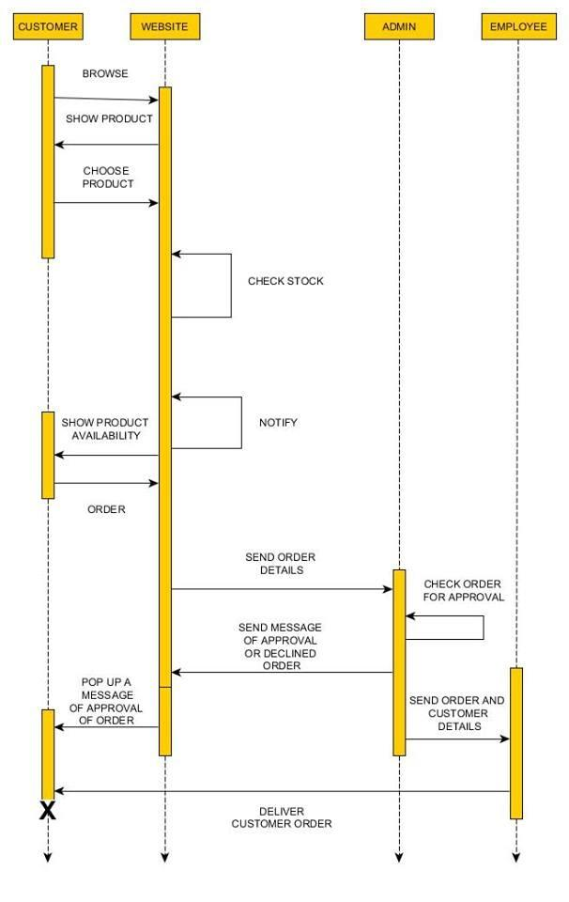
Figure 4.0Sequence Diagrams
The sequence diagram shows the
collaboration of objects based
on time sequence. It shows how the
objects interact with others
in a particular scenario of use case

Slide 20
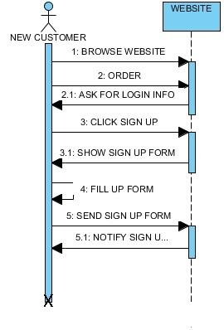
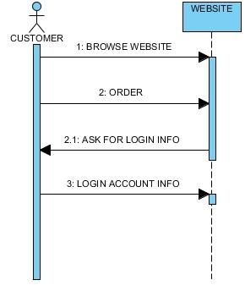
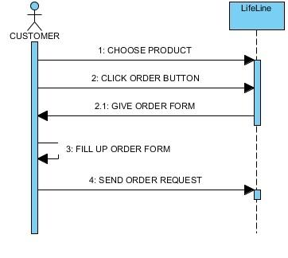
Figure 4.1 Sequence Diagram Sign up
Figure 4.2 Sequence Diagram Login
Figure 4.3 Sequence Diagram Order

Slide 21
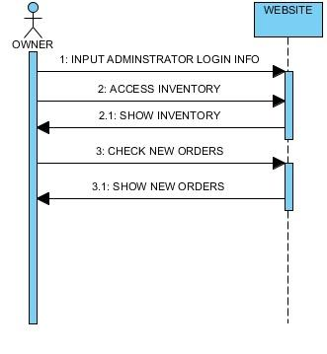
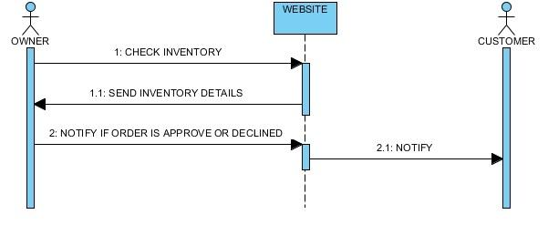
Figure 4.4 Sequence Diagram Check Order
Figure 4.5 Sequence Diagram Notify

Slide 22
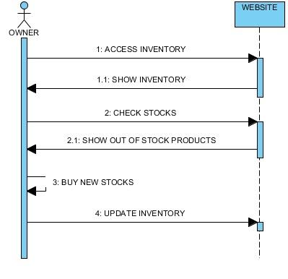
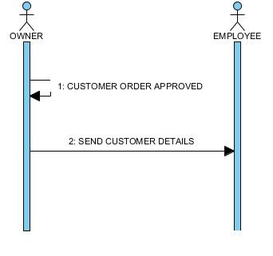
Figure 4.6 Sequence Diagram Update Inventory
Figure 4.7 Sequence Diagram Send Customer Details

Slide 23
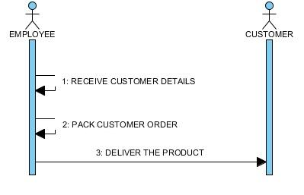
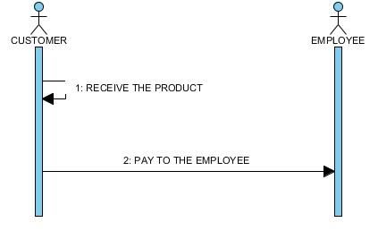
Figure 4.8 Sequence Diagram Deliver Product
Figure 4.9 Sequence Diagram Pay

Slide 24
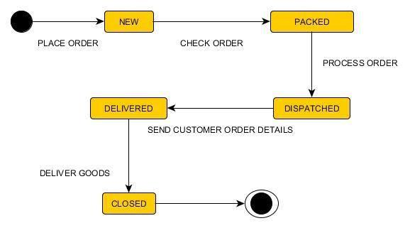
Figure 5.0 State Transition Diagram
State transition diagram shows the different state of an entity also how an entity
responds to various events by changing from one state to another.

Slide 25
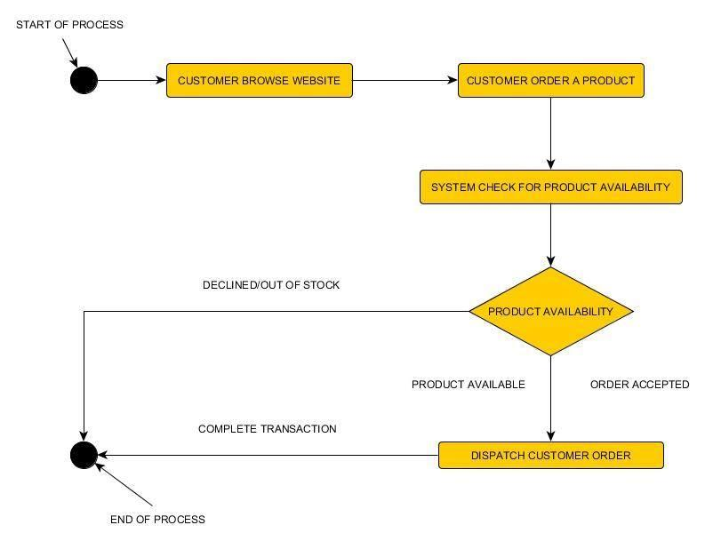
Figure 5.0 Activity Diagram
The activity diagram describes the flow of control of the target system, this diagram shows
the flow when a customer is browsing website and ordering a product.

Slide 26
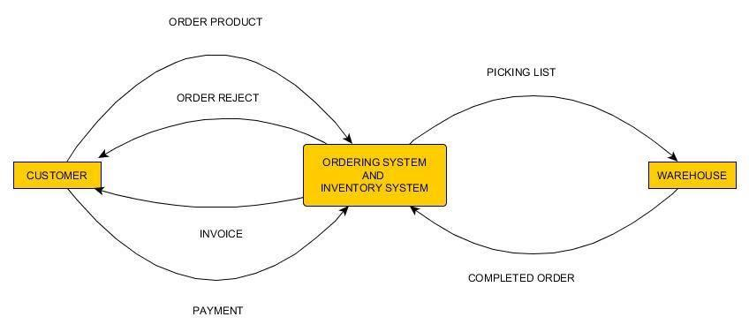
Figure 6.0 Context Flow Diagram
The Context Diagram shows the system under consideration as a single high-level process and then shows the relationship that the system has with other external entities. This diagram shows the different input to the system and the output of the system.

Slide 27
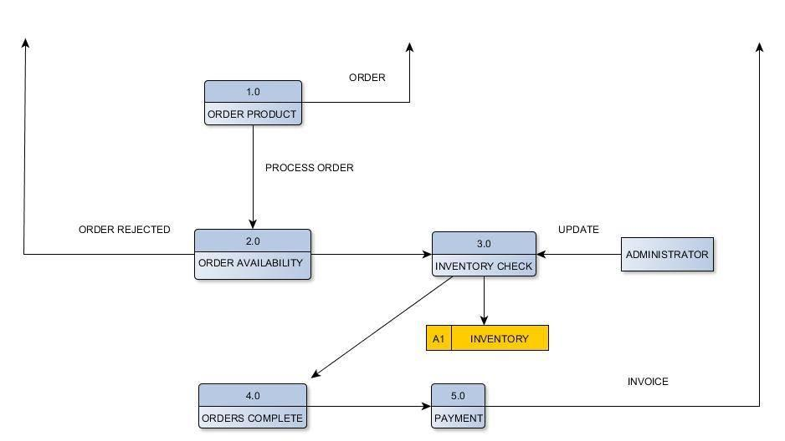
Figure 7.0 Data Flow Diagram
Data flow diagram maps out the flow of information for any process or system. This diagram shows the flow inside the ordering system.

Slide 28
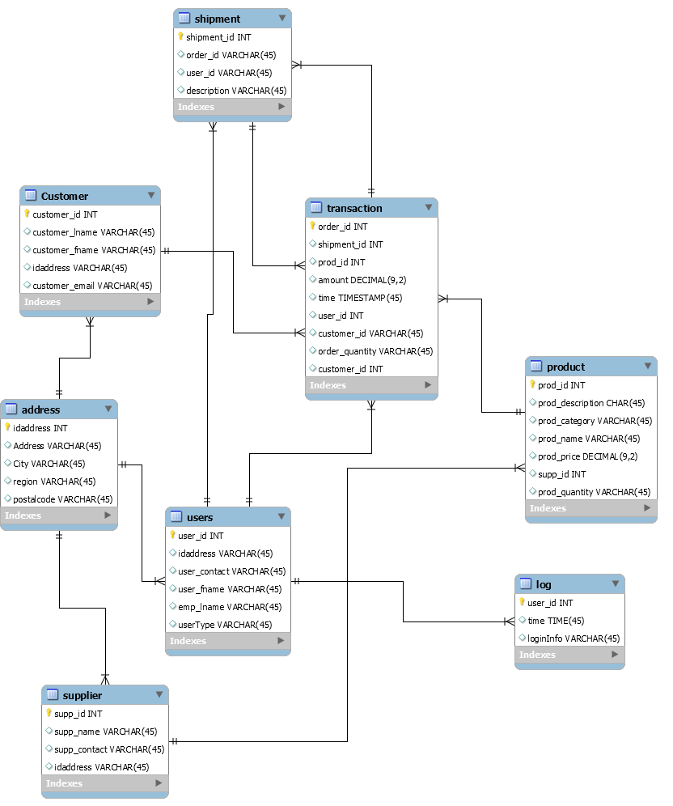
Entity Relationship Diagram

